Slide 1



Real Estate News Digest Chatbot
Arya Gangadkar Sunil

Slide 2

Background and Motivation
General-purpose LLMs like ChatGPT lack
real-time, domain-specific precision.
Our system is tailored to real estate news,
reducing bias and hallucination.
It delivers grounded answers by
retrieving from live sources like CNBC
instead of relying on outdated training data.

Slide 3

Research Questions
Can we build a focused RAG system that outperforms general-purpose LLMs in real estate Q&A tasks?
How do different similarity metrics (cosine vs dot product) and retrieval strategies (e.g., MMR) affect answer quality?
What preprocessing and fallback techniques help ensure consistent performance?

Slide 4



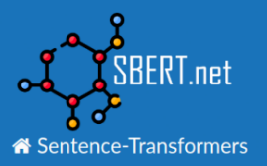


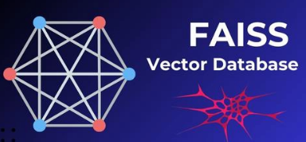



Framework
800
Normalized Vectors
Question
Chunks
Question + Chunks
Answer

Slide 5
Demo

Slide 6

Dataset(s) and Analysis

Slide 7


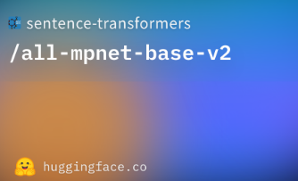

Results and Findings
Choosing Appropriate Chunk size and Temperature.
All-mpnet-base-v2 perfomed slightly better in preserving sentence level meaning.
Cosine Similarity has better consistency than raw dot product.
MMR Retrieval is better over “Simple top-k relevant” because of its inclusion in diversity.

Slide 8
Conclusion
A custom RAG pipeline with MMR and targeted embeddings outperforms general LLMs in precision and reliability.
Key enhancements—like chunk tuning, source validation, and MMR retrieval—reduced hallucinations and improved
trust.
The approach proves that focused retrieval + grounded generation = high-quality domain Q&A.

Slide 9

Discussion
1) How efficient is it for MMR and can it adapt to different contexts?
2) Can domain specific RAGs completely replace general purpose LLMs or should both be used together?

Slide 10
References
Youtube Tutorials : https://youtube.com/playlist?list=PLeo1K3hjS3uu7CxAacxVndI4bE_o3BDtO&feature=s hared
Lewis, Patrick, et al. Retrieval-Augmented Generation for Knowledge-Intensive NLP Tasks. Advances in Neural Information Processing Systems 33 (NeurIPS 2020). https://arxiv.org/abs/2005.11401

